Slide 1
Using Decentralized Learning to Reduce Communication in Column-Partitioned, Multi-Agent Systems
Zachary Atkins (zatkins@ku.edu) – University of Kansas
Agnieszka Miedlar (amiedlar@ku.edu) – University of Kansas
Chris Vogl (vogl2@llnl.gov) – Lawrence Livermore National Laboratory
March 3, 2021
Notes:
My name is Zachary Atkins, and I am a senior at the University of Kansas studying computer science and mathematics.
This minisymposium is the result of research done during my internship at Lawrence Livermore National Laboratory under the mentorship of Chris Vogl and in collaboration with Agnieszka Miedlar from the department of mathematics at the University of Kansas.

Slide 2

Special Thanks and Acknowledgements
This work is supported by the U.S. Department of Energy’s Office of Energy Efficiency and Renewable Energy (EERE) under Solar Energy Technologies Office (SETO) Agreement Number 34229.
Notes:
Before I begin, I would like to thank the Department of Energy’s Office of Energy Efficiency and Renewable Energy for supporting the research discussed in my presentation.
We begin with a motivating use-case for edge-device computing.

Slide 3
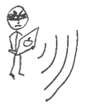



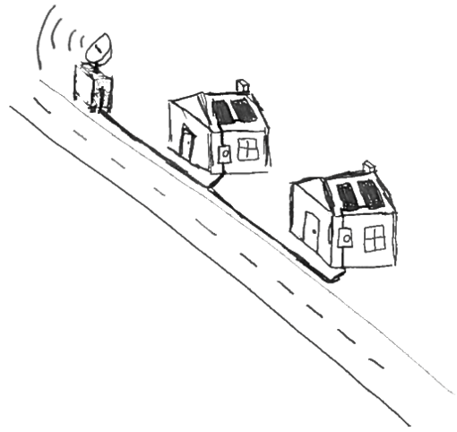
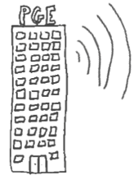
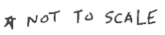
Motivation Scenario: Enabling Grid Resilience through Command Verification
Distributed Energy Resource Management System (DERMS)
DERMS
pwn
ERR: pwn
cmd
Smart Inverters
Original Illustration by Dan Merl (merl1@llnl.gov)
Notes:
Distributed energy resource management systems (DERMS) introduce new challenges to security in grid management and control. A potential solution augments centralized commands with decentralized, data-driven command verification at the inverter level. In this framework, we seek to verify whether a received command is warranted by predicting critical values, such as the voltage at an upstream substation. This prediction uses locally available data, such as the voltage at the current inverter. We consider a generic threat scenario to illustrate how such a verification system would operate.
Here we have our DERMS, which in this case is managing a group of residential solar panels and smart inverters.
Suppose the utility company wants to send a command to the DERMS to change its inverters’ behavior.
Upon receiving the command, the DERMS will tell its devices to predict the relevant critical values and determine the appropriateness of the command.
After verifying the command, it is accepted by the DERMS and passed to the devices.
On the other hand, suppose an adversary attempts to send a malicious command to the DERMS which would damage the grid.
The DERMS will again ask the inverters for verification of the command.
Since the inverters predict a critical value that does not justify executing the command, it is rejected by the DERMS and forwarded to the utility provider for further analysis.

Slide 4
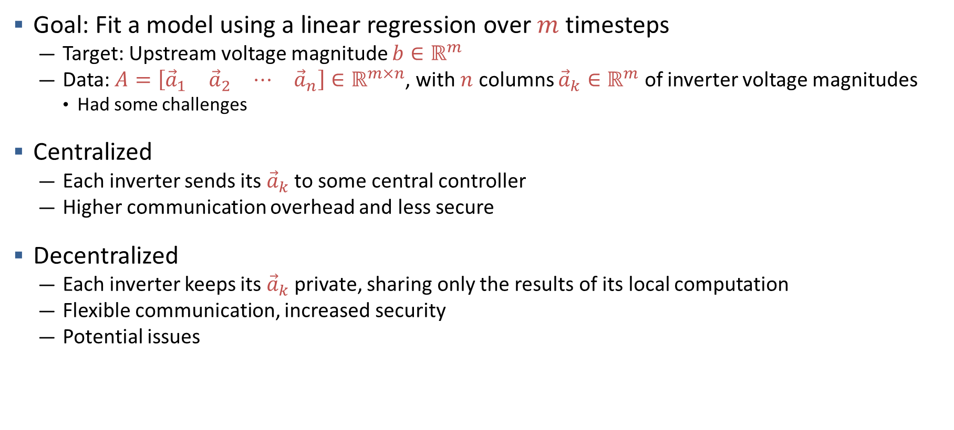
Motivation Grid State Prediction
Goal: Fit a model using a linear regression over $m$ timesteps
Target: Upstream voltage magnitude $b∈ℝ^{m}$
Data: $A=\left[\begin{matrix}{\vec{a}}_{1} & {\vec{a}}_{2} & ⋯ & {\vec{a}}_{n}\end{matrix}\right]∈ℝ^{m×n}$, with $n$ columns ${\vec{a}}_{k}∈ℝ^{m}$ of inverter voltage magnitudes
Had some challenges
Centralized
Each inverter sends its ${\vec{a}}_{k}$ to some central controller
Higher communication overhead and less secure
Decentralized
Each inverter keeps its ${\vec{a}}_{k}$ private, sharing only the results of its local computation
Flexible communication, increased security
Potential issues
Notes:
The pressing issue is how to most effectively predict the current and future grid state
Our solution was a regression model trained on $m$ timesteps of inverter voltages.
This data had some challenges however, which we will discuss in greater detail later.
The question remains – how best can we perform this regression?
One option would be to send the inverter measurements back to a central command and control server, but this would be
Communication intensive
Slow
Vulnerable to a wide range of threat vectors due to the presence of a single point of failure, the central controller
We instead considered the use of these SMART inverters as decentralized compute units, which would only communicate locally to predict the state of the grid
This method offers some key advantages:
lower communication overhead due to reduced data sharing and physically closer data targets
easily scalable across a variety of network topologies
far less vulnerable to network outages and malicious actors
But also some potential issues:
hard to ensure convergence
In order to better visualize the options, consider the following: [NEXT SLIDE]

Slide 5
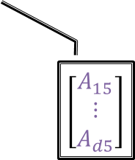
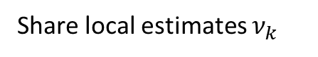
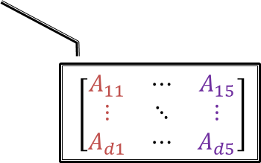
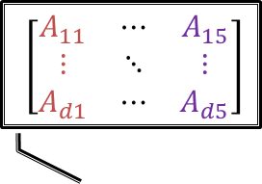
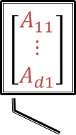
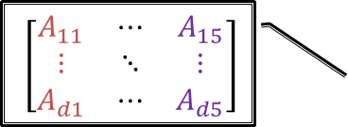
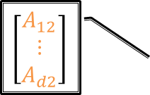
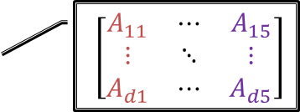
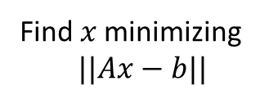
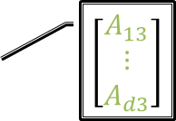
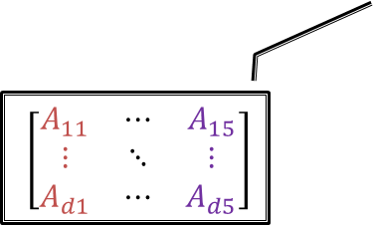
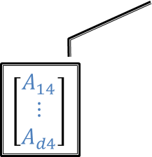
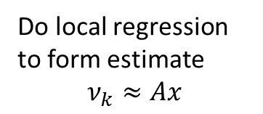
Motivation Communication Costs: A Brief Visualization
$\left[\begin{matrix}A_{11} & ⋯ & A_{15} \\ ⋮ & ⋱ & ⋮ \\ A_{d1} & ⋯ & A_{d5}\end{matrix}\right]$
$\left[\begin{matrix}A_{11} \\ ⋮ \\ A_{d1}\end{matrix}\right]$
Collocated
Regression
Find 𝑥 minimizing
$$||Ax−b||$$
Decentralized
Regression
$\left[\begin{matrix}A_{11} & ⋯ & A_{15} \\ ⋮ & ⋱ & ⋮ \\ A_{d1} & ⋯ & A_{d5}\end{matrix}\right]$
?
$\left[\begin{matrix}A_{12} \\ ⋮ \\ A_{d2}\end{matrix}\right]$
$\left[\begin{matrix}A_{11} & ⋯ & A_{15} \\ ⋮ & ⋱ & ⋮ \\ A_{d1} & ⋯ & A_{d5}\end{matrix}\right]$
$\left[\begin{matrix}A_{13} \\ ⋮ \\ A_{d3}\end{matrix}\right]$
?
?
Share data
Do local regression to form estimate
$$ν_{k}≈Ax$$
Do local regression
Share local estimates $ν_{k}$
?
?
But only with neighbors
$\left[\begin{matrix}A_{14} \\ ⋮ \\ A_{d4}\end{matrix}\right]$
$\left[\begin{matrix}A_{15} \\ ⋮ \\ A_{d5}\end{matrix}\right]$
$\left[\begin{matrix}A_{11} & ⋯ & A_{15} \\ ⋮ & ⋱ & ⋮ \\ A_{d1} & ⋯ & A_{d5}\end{matrix}\right]$
$\left[\begin{matrix}A_{11} & ⋯ & A_{15} \\ ⋮ & ⋱ & ⋮ \\ A_{d1} & ⋯ & A_{d5}\end{matrix}\right]$
Notes:
To further motivate the use of decentralized learning, let us compare its computation and communication costs against a collocated alternative. Given 5 computational nodes, for example smart inverters, we first consider a collocated regression.
The nodes start with only their local data.
Each node must share its local data with every other node, allowing for the local reconstruction of the entire data matrix. This requires sending and receiving 4 columns of data per node.
After that, each node performs regression on the full dataset which clearly involves many redundant computations.
On the other hand, our decentralized method can eliminate redundant computations by utilizing only local data.
First, each node performs regression on its local portion of the data. This reduces the computational complexity on each node by a factor of 5 squared.
Then each node shares its local estimate of $A$ times $x$ –
But only with its neighboring nodes, meaning that communication costs can be halved.

Slide 6
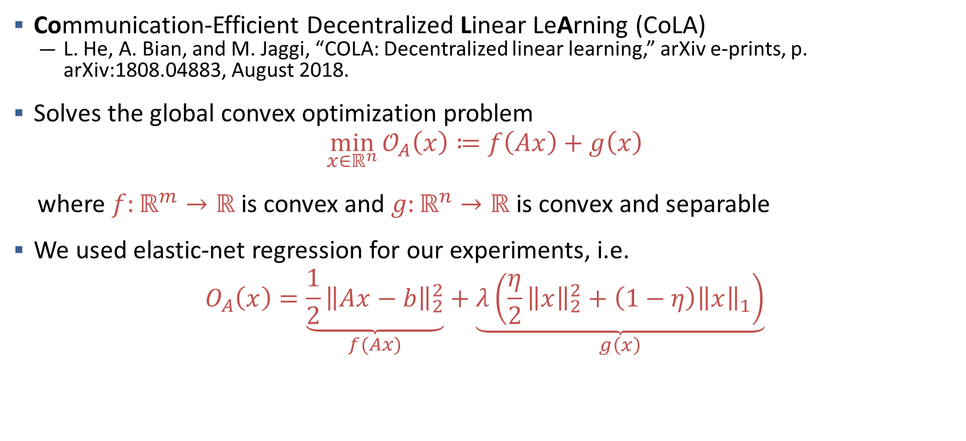

Decentralized Convex Optimization via CoLA Global Problem
Communication-Efficient Decentralized Linear LeArning (CoLA)
L. He, A. Bian, and M. Jaggi, “COLA: Decentralized linear learning,” arXiv e-prints, p. arXiv:1808.04883, August 2018.
Solves the global convex optimization problem
$$\begin{aligned}\min_{x∈ℝ^{n}}{𝒪_{A}\left(x\right)≔f\left(Ax\right)+g\left(x\right)}\#\end{aligned}$$ where $f:ℝ^{m}→ℝ$ is convex and $g:ℝ^{n}→ℝ$ is convex and separable
We used elastic-net regression for our experiments, i.e.
$$O_{A}\left(x\right)=\underset{f(Ax)}{\underbrace{{\frac{1}{2}\left\|Ax−b\right\|}_{2}^{2}}}+\underset{g\left(x\right)}{\underbrace{λ\left(\frac{η}{2}{\left\|x\right\|}_{2}^{2}+\left(1−η\right){\left\|x\right\|}_{1}\right)}}$$
$$f(Ax)$$
Notes:
The particular algorithm we considered for our application was CoLA, short for Communication-Efficient Decentralized Linear Learning, developed by He, Bian, and Jaggi.
CoLA is an extension of the CoCoA algorithm to the decentralized setting. The CoCoA algorithm is a centralized algorithm for convex optimization which has been shown to outperform competing methods such as Alternating Direction Method of Multipliers (ADMM) and distributed Stochastic Gradient Descent in the cases of convex problems, making its extension to the decentralized setting particularly promising.
CoLA seeks to minimize a general, regularized convex problem O-A of x, which is composed of a convex objective, or loss, function f(Ax) and a convex, separable regularization function g(x).
In the original CoLA literature, the authors considered several choices for f and g,
including Lasso and Ridge regressions in the primal space and SVD in the dual space.
For our experiments, we chose to use Elastic-Net regression, as it provided improved flexibility in the regularization conditions.
In order to solve O-A of x in a decentralized fashion, it is necessary to distribute the computation of f and g over the various computational nodes.
Since g is separable, it natively supports this distributed model. Thus, the challenge of CoLA lies in distributing f, [NEXT ANIM] since it relies on the global matrix-vector multiplication Ax.

Slide 7
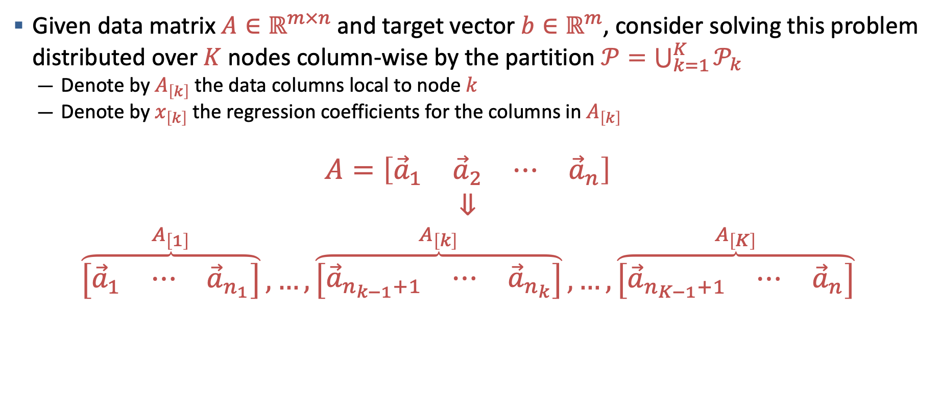
Decentralized Convex Optimization via CoLA Column Partitioning
Given data matrix $A∈ℝ^{m×n}$ and target vector $b∈ℝ^{m}$, consider solving this problem distributed over $K$ nodes column-wise by the partition $𝒫=\bigcup_{k=1}^{K}{𝒫_{k}}$
Denote by $A_{\left[k\right]}$ the data columns local to node $k$
Denote by $x_{\left[k\right]}$ the regression coefficients for the columns in $A_{\left[k\right]}$
$$A=\left[\begin{matrix}{\vec{a}}_{1} & {\vec{a}}_{2} & ⋯ & {\vec{a}}_{n}\end{matrix}\right]$$
$$⇓$$
$$\overset{A_{\left[1\right]}}{\overbrace{\left[\begin{matrix}{\vec{a}}_{1} & ⋯ & {\vec{a}}_{n_{1}}\end{matrix}\right]}},…, \overset{A_{\left[k\right]}}{\overbrace{\left[\begin{matrix}{\vec{a}}_{n_{k−1}+1} & ⋯ & {\vec{a}}_{n_{k}}\end{matrix}\right]}},…,\overset{A_{\left[K\right]}}{\overbrace{\left[\begin{matrix}{\vec{a}}_{n_{K−1}+1} & ⋯ & {\vec{a}}_{n}\end{matrix}\right]}}$$
Notes:
Before diving into the details of the local optimization problems, we first consider in greater detail the partitioning of our data matrix.
Unlike many other decentralized algorithms for convex optimization, CoLA allows for primal or dual formulations, providing necessary flexibility in the partitioning of our data. Specifically, state-of-the-art algorithms such as the Alternating Direction Method of Multipliers (ADMM), only allow for convex optimization in the dual space, requiring row-partitioned data.
In our use-case, column-wise partitioning was necessary to realize our desired communication gains.
Given the data matrix $A∈ℝ^{m×n}$ and target vector $b∈ℝ^{m}$, we seek to partition the columns of $A$ over $K$ computational nodes. Each node $k$ will then have $n_{k}$ columns of data $A_{\left[k\right]}$ and will compute the corresponding regression coefficients $x_{\left[k\right]}$.

Slide 8
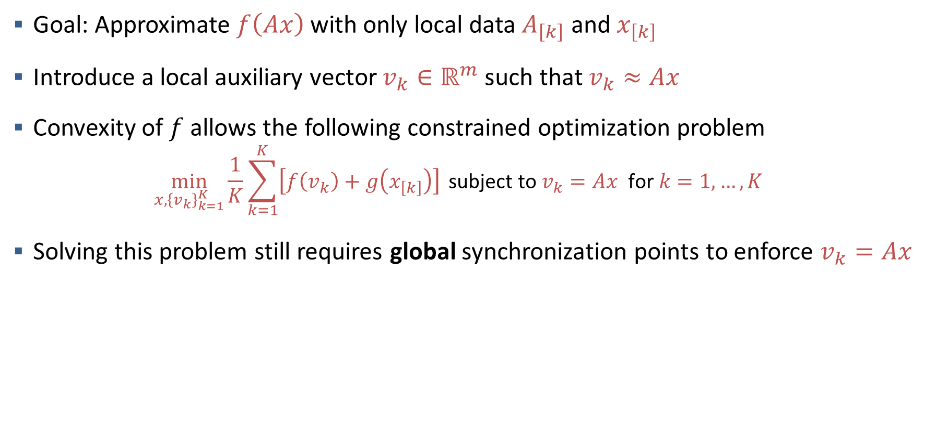
Decentralized Convex Optimization via CoLA Centralized Local Sub-Problems
Goal: Approximate $f\left(Ax\right)$ with only local data $A_{\left[k\right]}$ and $x_{\left[k\right]}$
Introduce a local auxiliary vector $v_{k}∈ℝ^{m}$ such that $v_{k}≈Ax$
Convexity of $f$ allows the following constrained optimization problem
$$\min_{x,{\left\{v_{k}\right\}}_{k=1}^{K}}{\frac{1}{K}\sum_{k=1}^{K}{\left[f\left(v_{k}\right)+g\left(x_{\left[k\right]}\right)\right]} }\text{subject} \text{to} v_{k}=Ax \text{for} k=1,…,K$$
Solving this problem still requires global synchronization points to enforce $v_{k}=Ax$
Notes:
In order to solve the global optimization problem in a decentralized environment, we must construct an approximation of the objective function $f$ which relies only on local data.
To aid in this process, we introduce a local approximation of the global matrix-vector product $Ax$, denoted $v_{k}.$
It is important to note that $v_{k}$ is, and will continue to be, the only quantity shared directly between nodes.
We can then use $v_{k}$ as a substitute for $Ax$ in the global optimization problem.
Additionally, since $f$ is convex, we can rewrite the global quantity $f\left(Ax\right)$ as the average of the local approximations.
Note that this formulation is equivalent to the global problem if, and only if, the constraint $v_{k}=Ax$is satisfied at every node.
This presents an issue, as enforcing this constraint requires all-to-all communication and thus, global synchronization points

Slide 9
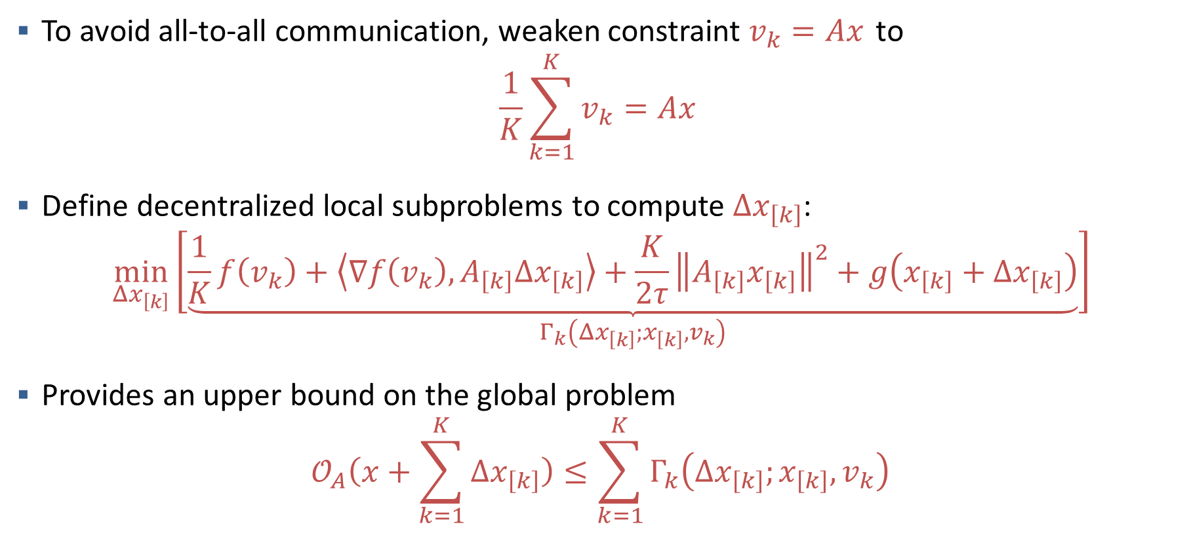
Decentralized Convex Optimization via CoLA Decentralized Local Sub-Problems
To avoid all-to-all communication, weaken constraint $v_{k}=Ax$ to
$$\frac{1}{K}\sum_{k=1}^{K}{v_{k}}=Ax$$
Define decentralized local subproblems to compute $Δx_{\left[k\right]}$:
$$\begin{aligned} \min_{Δx_{\left[k\right]}}{\underset{Γ_{k}\left(Δx_{\left[k\right]};x_{\left[k\right]},v_{k}\right)}{\left[\underbrace{\frac{1}{K}f\left(v_{k}\right)+\left\langle ∇f\left(v_{k}\right), A_{\left[k\right]}Δx_{\left[k\right]}\right\rangle +\frac{K}{2τ}{\left\|A_{\left[k\right]}x_{\left[k\right]}\right\|}^{2}+g\left(x_{\left[k\right]}+Δx_{\left[k\right]}\right)}\right]}}\end{aligned}$$
Provides an upper bound on the global problem
$$𝒪_{A}\left(x+\sum_{k=1}^{K}{Δx_{\left[k\right]}}\right)≤\sum_{k=1}^{K}{Γ_{k}\left(Δx_{\left[k\right]};x_{\left[k\right]},v_{k}\right)}$$
Notes:
To avoid these global synchronization points, we must weaken the constraint on $v_{k}$ by requiring only that the average of the local approximations is equal to the global quantity $Ax$.
We are able to use this weakened constraint primarily due to the convexity of $f.$
Further, the decentralized local subproblems $Γ_{k}$ attempt to minimize over the local updates $Δx_{\left[k\right]}$. These subproblems use a quadratic approximation of the global problem, and we showed in our work that the sum of these local subproblems provide an upper bound on the value of the global optimization problem.

Slide 10
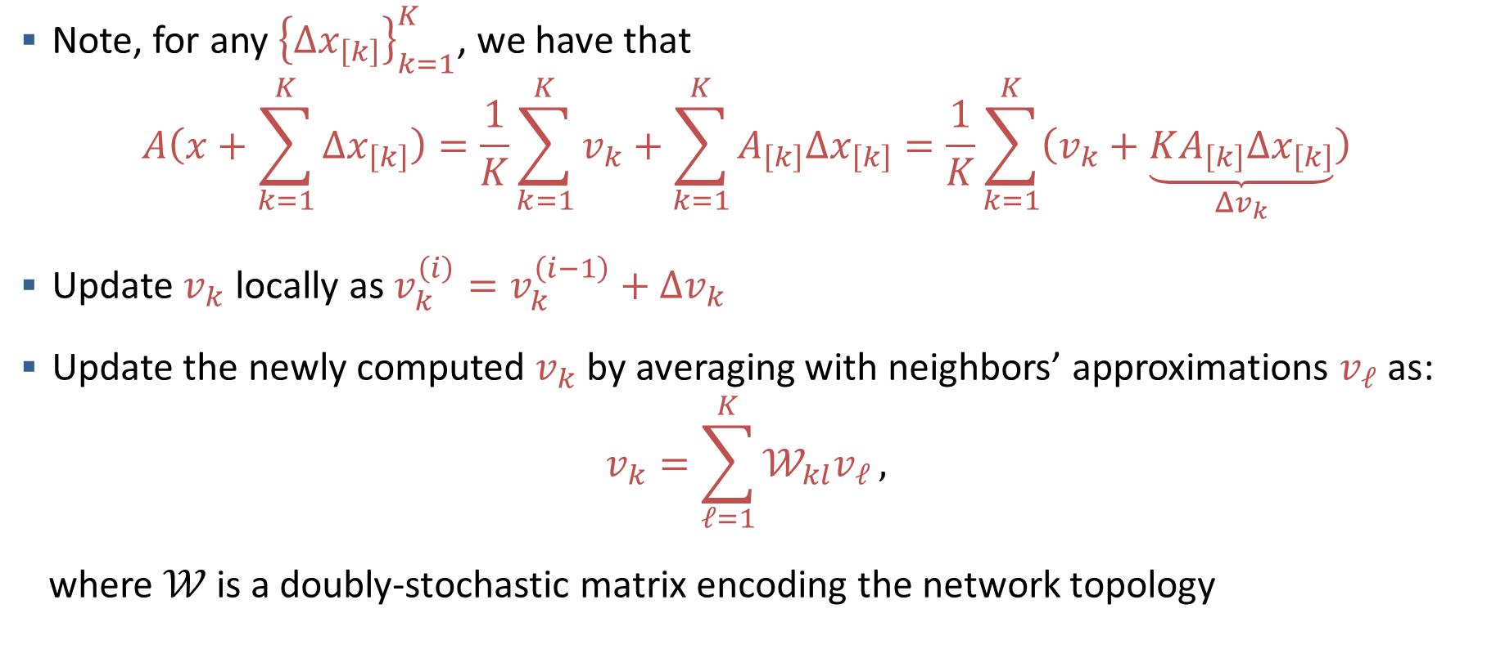
Decentralized Convex Optimization via CoLA Updating Local Approximations
Note, for any ${\left\{Δx_{\left[k\right]}\right\}}_{k=1}^{K}$, we have that
$$A\left(x+\sum_{k=1}^{K}{Δx_{\left[k\right]}}\right)=\frac{1}{K}\sum_{k=1}^{K}{v_{k}}+\sum_{k=1}^{K}{A_{\left[k\right]}Δx_{\left[k\right]}}=\frac{1}{K}\sum_{k=1}^{K}{\left(v_{k}+\underset{Δv_{k}}{\underbrace{KA_{\left[k\right]}Δx_{\left[k\right]}}}\right)}$$
Update $v_{k}$ locally as $v_{k}^{\left(i\right)}=v_{k}^{\left(i−1\right)}+Δv_{k}$
Update the newly computed $v_{k}$ by averaging with neighbors’ approximations $v_{ℓ}$ as:
$$v_{k}=\sum_{ℓ=1}^{K}{𝒲_{kl}v_{ℓ}},$$ where $𝒲$ is a doubly-stochastic matrix encoding the network topology
Notes:
In order to enforce the constraint on the averaged $v_{k}$’s, we must update $v_{k}$ by $K$ times the product of $A_{\left[k\right]}$ and $x_{\left[k\right]}$
Each node then shares its newly computed local approximation with each of its neighbors according to a doubly stochastic mixing matrix.
In practice, this typically means averaging its own and each of its neighbors’ local approximations
Similarly to the local updates, the global constraint on the averaged $v_{k}$’s is maintained by the double-stochasticity of the mixing matrix $𝒲$

Slide 11
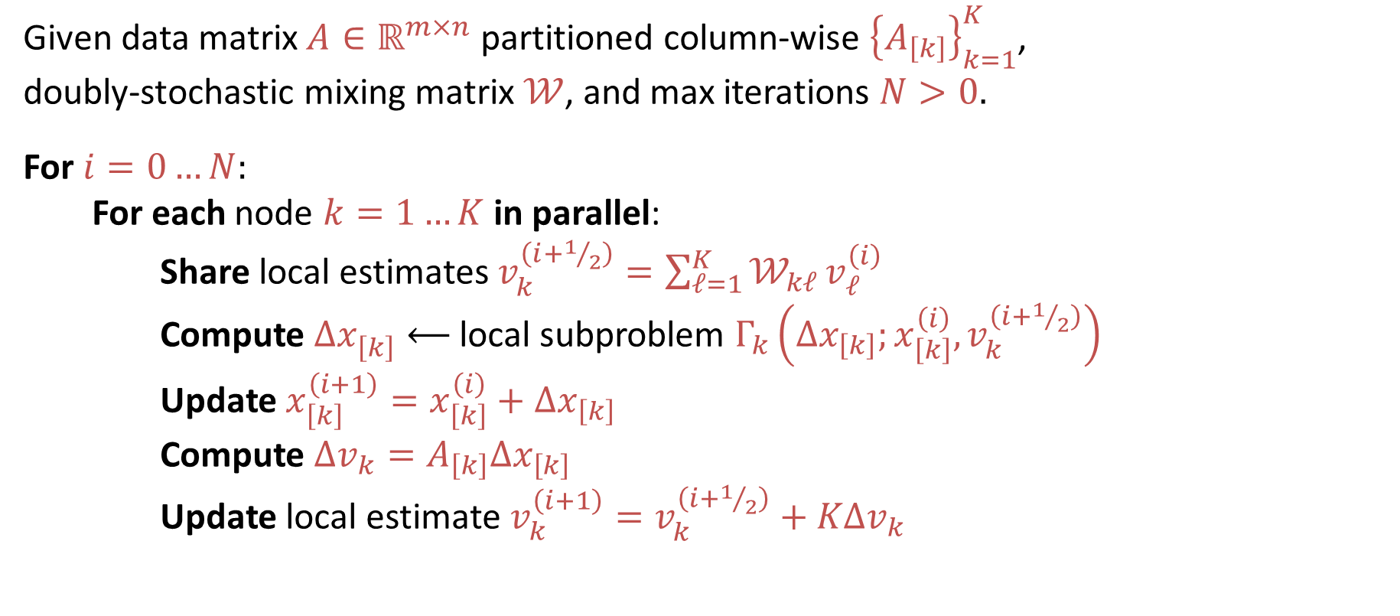
Decentralized Convex Optimization via CoLA The (Abridged) CoLA Algorithm
Given data matrix $A∈ℝ^{m×n}$ partitioned column-wise ${\left\{A_{\left[k\right]}\right\}}_{k=1}^{K}$, doubly-stochastic mixing matrix $𝒲$, and max iterations $N>0.$
For $i=0…N:$ For each node $k=1…K$ in parallel: Share local estimates $v_{k}^{\left(i+1/2\right)}=\sum_{ℓ=1}^{K}{𝒲_{kℓ}}v_{ℓ}^{\left(i\right)}$ Compute ${Δx}_{\left[k\right]}^{ }⟵$local subproblem $Γ_{k}\left(Δx_{\left[k\right]};x_{\left[k\right]}^{\left(i\right)},v_{k}^{\left(i+1/2\right)}\right)$ Update $x_{\left[k\right]}^{\left(i+1\right)}=x_{\left[k\right]}^{\left(i\right)}+Δx_{\left[k\right]}$ Compute $Δv_{k}=A_{\left[k\right]}Δx_{\left[k\right]}$ Update local estimate $v_{k}^{\left(i+1\right)}=v_{k}^{\left(i+1/2\right)}+KΔv_{k}$
Notes:
To briefly describe the CoLA algorithm,
During each global iteration, each node will
first, share its local estimates $v_{k}$ with its neighbors
second, use its new local estimate, as well as its prior regression coefficients, to compute the local update $Δx_{\left[k\right]}$
third, update $x_{\left[k\right]}$ using the computed update
fourth, use the local update to $x_{k}$ to compute its local update to $v_{k}$
and finally, update its local estimate using the shared local approximation and its computed update

Slide 12
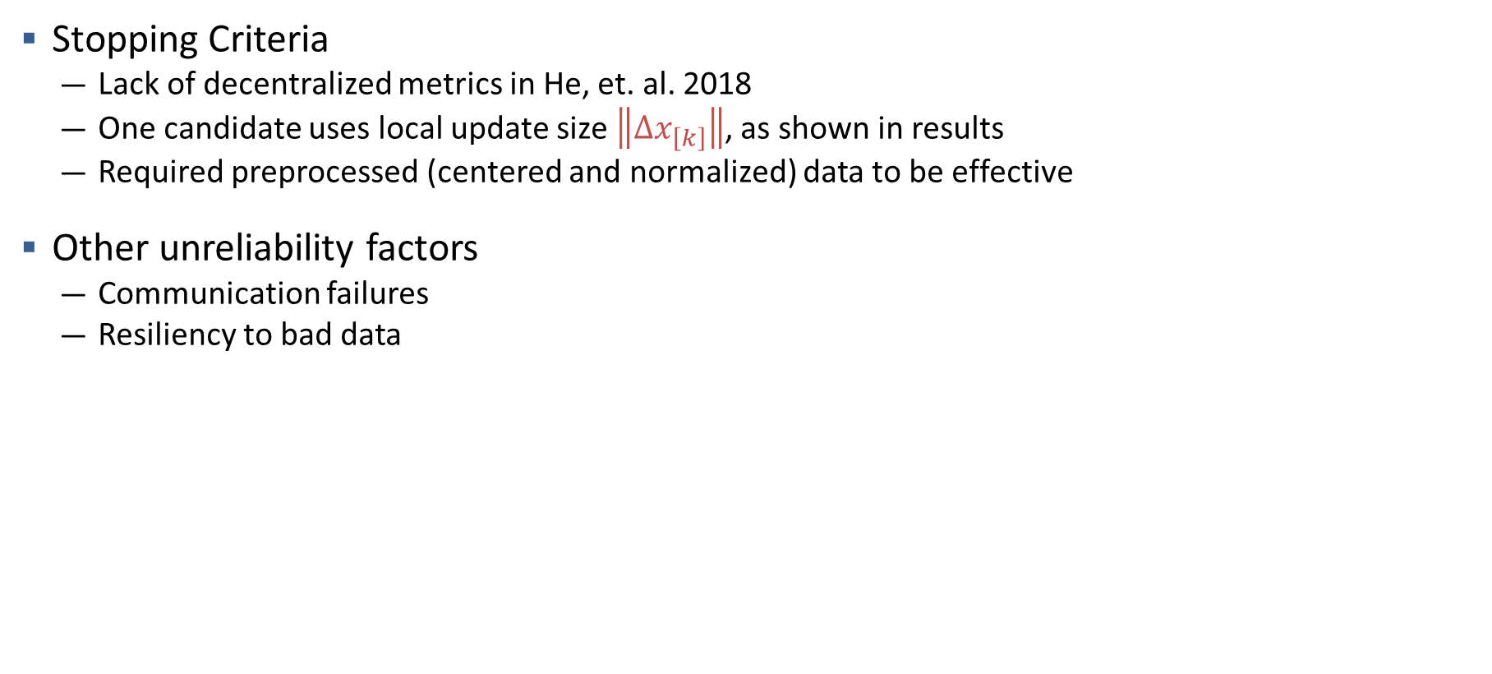
Decentralized Convex Optimization via CoLA Future Directions
Stopping Criteria
Lack of decentralized metrics in He, et. al. 2018
One candidate uses local update size $\left\|Δx_{\left[k\right]}\right\|$, as shown in results
Required preprocessed (centered and normalized) data to be effective
Other unreliability factors
Communication failures
Resiliency to bad data
Notes:
As presented, the CoLA algorithm lacks a clear local stopping criteria.
The original paper presented some “local certificates for global accuracy” but we found that the given local quantities showed little, if any, convergence throughout the execution of the algorithm.
This is likely due primarily to the conditioning of our data, but the challenges persisted regardless of the preprocessing of the data.
As such, we sought a more effective local stopping criteria.
We considered several options, but the most promising was the magnitude of the local updates $Δx_{\left[k\right]}$
However, as we will see in the numerical results, this was only effective if the data was preprocessed
This preprocessing was not universally required, however, and we found that the local updates converged far better for well conditioned data.
Additionally, in order to be applicable for our desired use case, the CoLA algorithm will require further mitigation features for unreliability
intermittent node connection failure
resilience to bad data, whether due to data corruption or malicious data

Slide 13
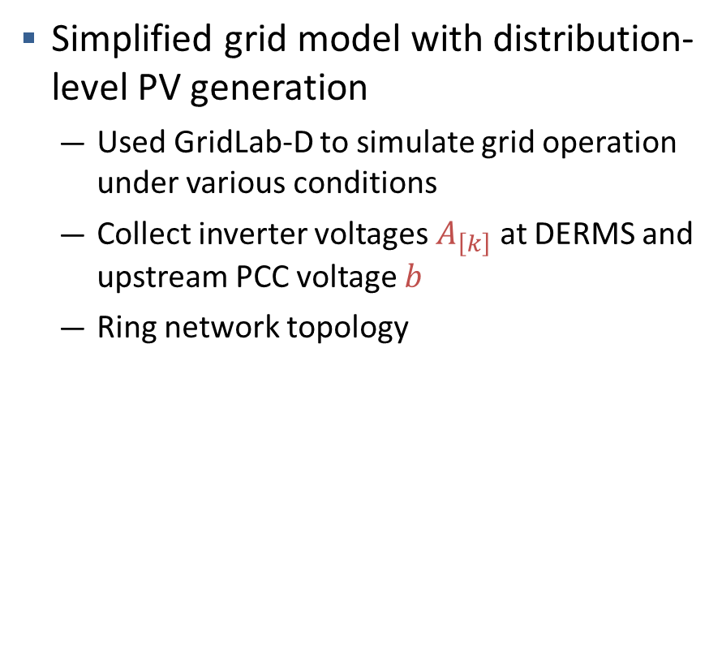
Experiments Power Distribution Grid State Prediction
Simplified grid model with distribution-level PV generation
Used GridLab-D to simulate grid operation under various conditions
Collect inverter voltages $A_{\left[k\right]}$ at DERMS and upstream PCC voltage $b$
Ring network topology
Notes:
Our experiments were performed with a dataset composed of columns of SMART Inverter voltages, and we sought to predict the voltage at a meter upstream of those inverters.
Unfortunately, the resulting data matrix was extremely poorly conditioned. As a result, preprocessing of the data was not only helpful, but necessary, to attaining useful results.
Our preconditioning involved centering and normalizing the data column-wise, and was performed in a fully decentralized fashion, requiring only the local data column and the target vector $b.$
In order to gather this data, we used a simplified grid model, shown here, which had distribution-level photovoltaic power generation. We used Gridlab-D to test this grid under various conditions and with various levels of photovoltaic power penetration.
When running our computational experiments, we used a ring network topology. We found that this topology provided the best balance between ensuring regression quality and reducing communication.

Slide 14
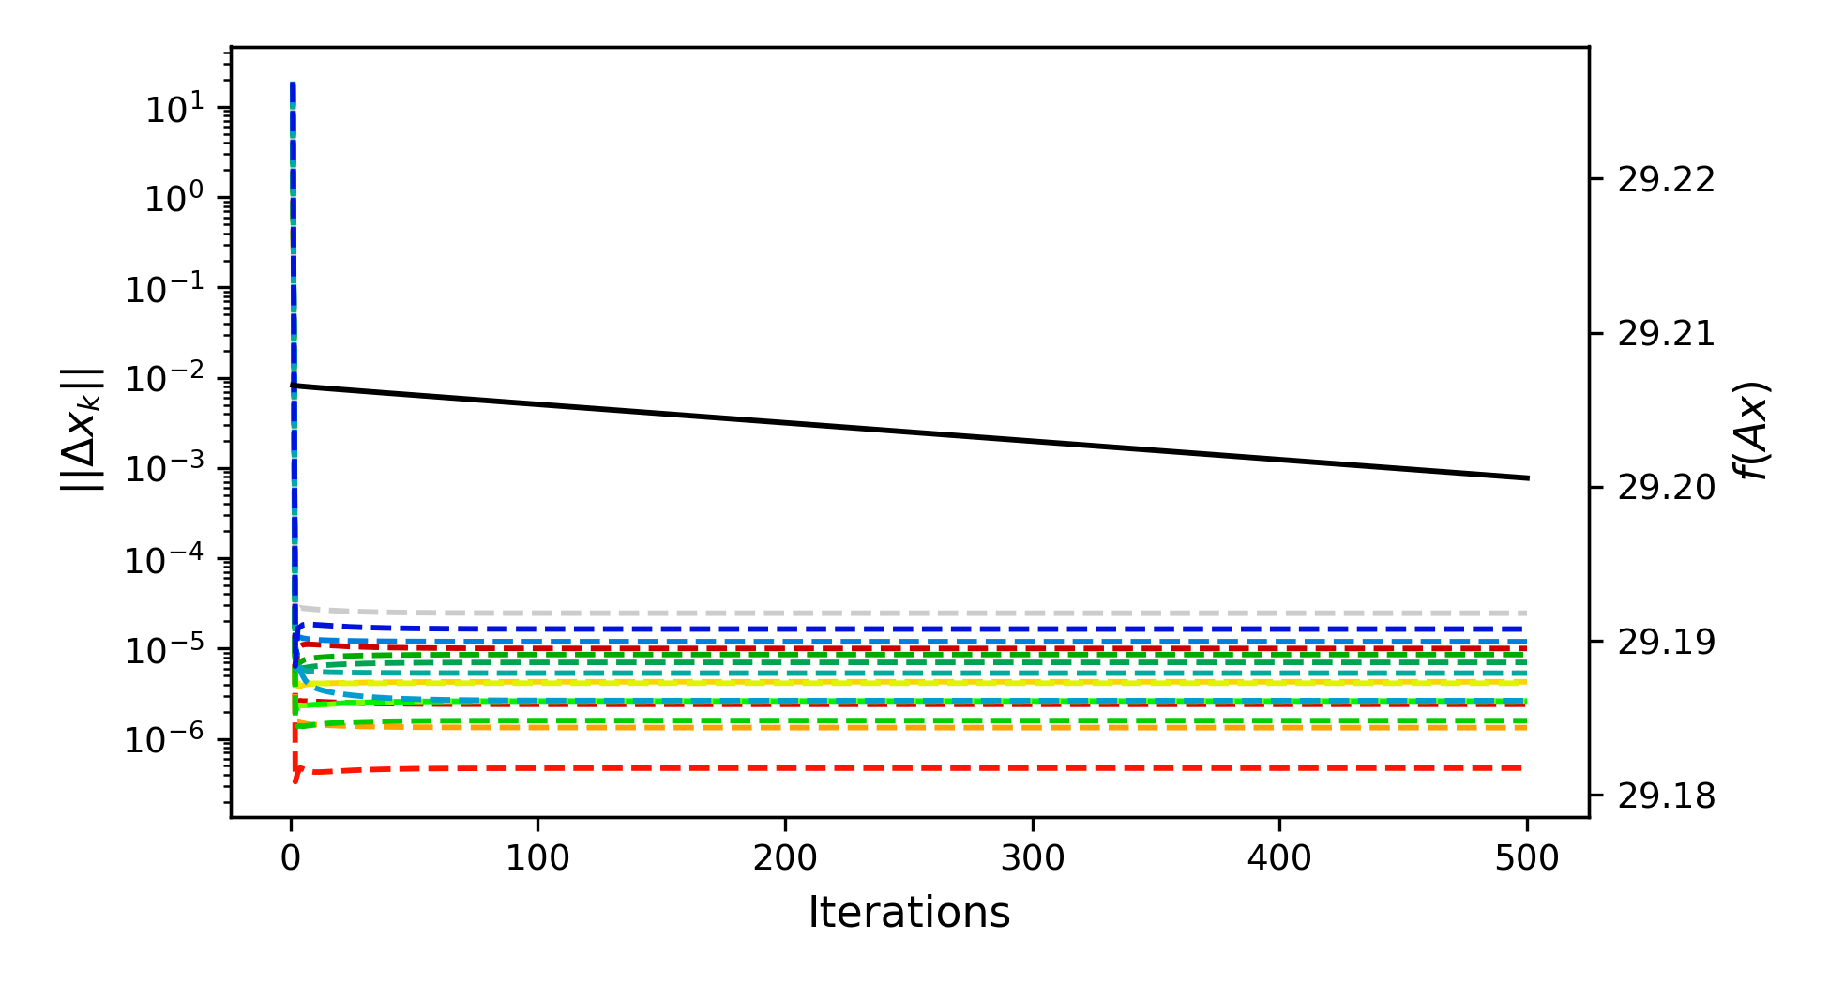
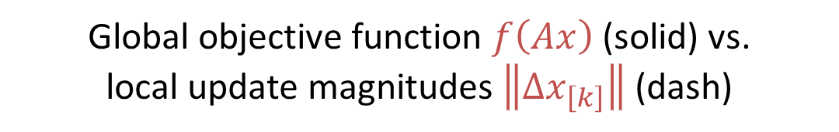
Results – Stopping Criteria No Preprocessing, Realistic PV Penetration (~5% total generation)
Global objective function $f\left(Ax\right)$ (solid) vs.
local update magnitudes $\left\|Δx_{\left[k\right]}\right\|$ (dash)
Notes:
As stated before, the data gathered from our simulations was extremely poorly conditioned.
This graph demonstrates the effects of this poor conditioning on convergence behavior;
specifically, the local updates immediately stagnate, preventing their use as a potential stopping criteria.
Additionally, the convergence of the objective function is also extremely slow.

Slide 15
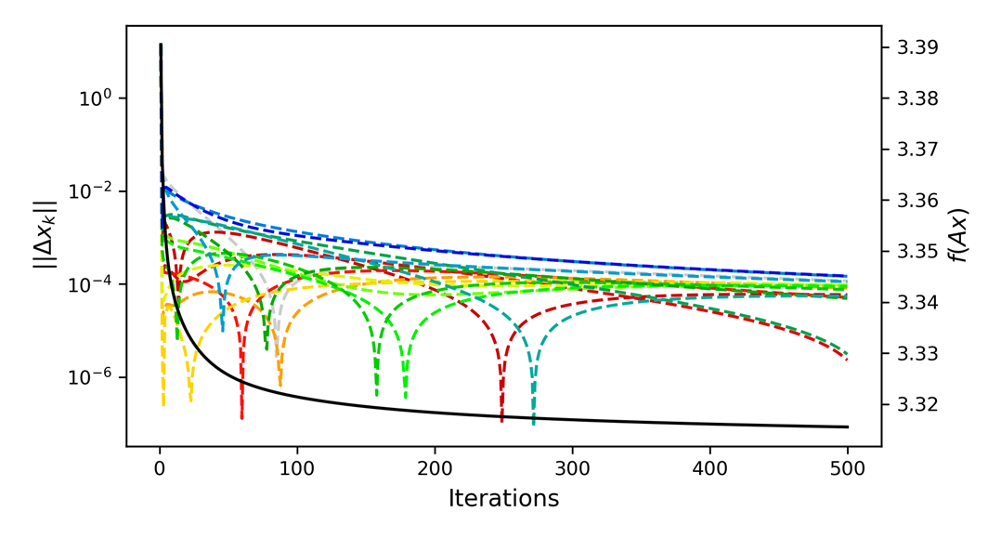
Results – Stopping Criteria With Preprocessing, Realistic PV Penetration (~5%)
Global objective function $f\left(Ax\right)$ (solid) vs.
local update magnitudes $\left\|Δx_{\left[k\right]}\right\|$ (dash)
Notes:
After applying preprocessing, however, we saw dramatic improvements in the convergence behavior.
Unlike in the prior experiment, the global objective function appears to quickly converge to its minimal value.
Additionally, the local updates no longer stagnate, and instead are (mostly) decreasing. The sharp dips present in the local updates are most likely due to the slow propagation of updates in a ring topology, as they appear to decrease in frequency as more iterations are performed.

Slide 16
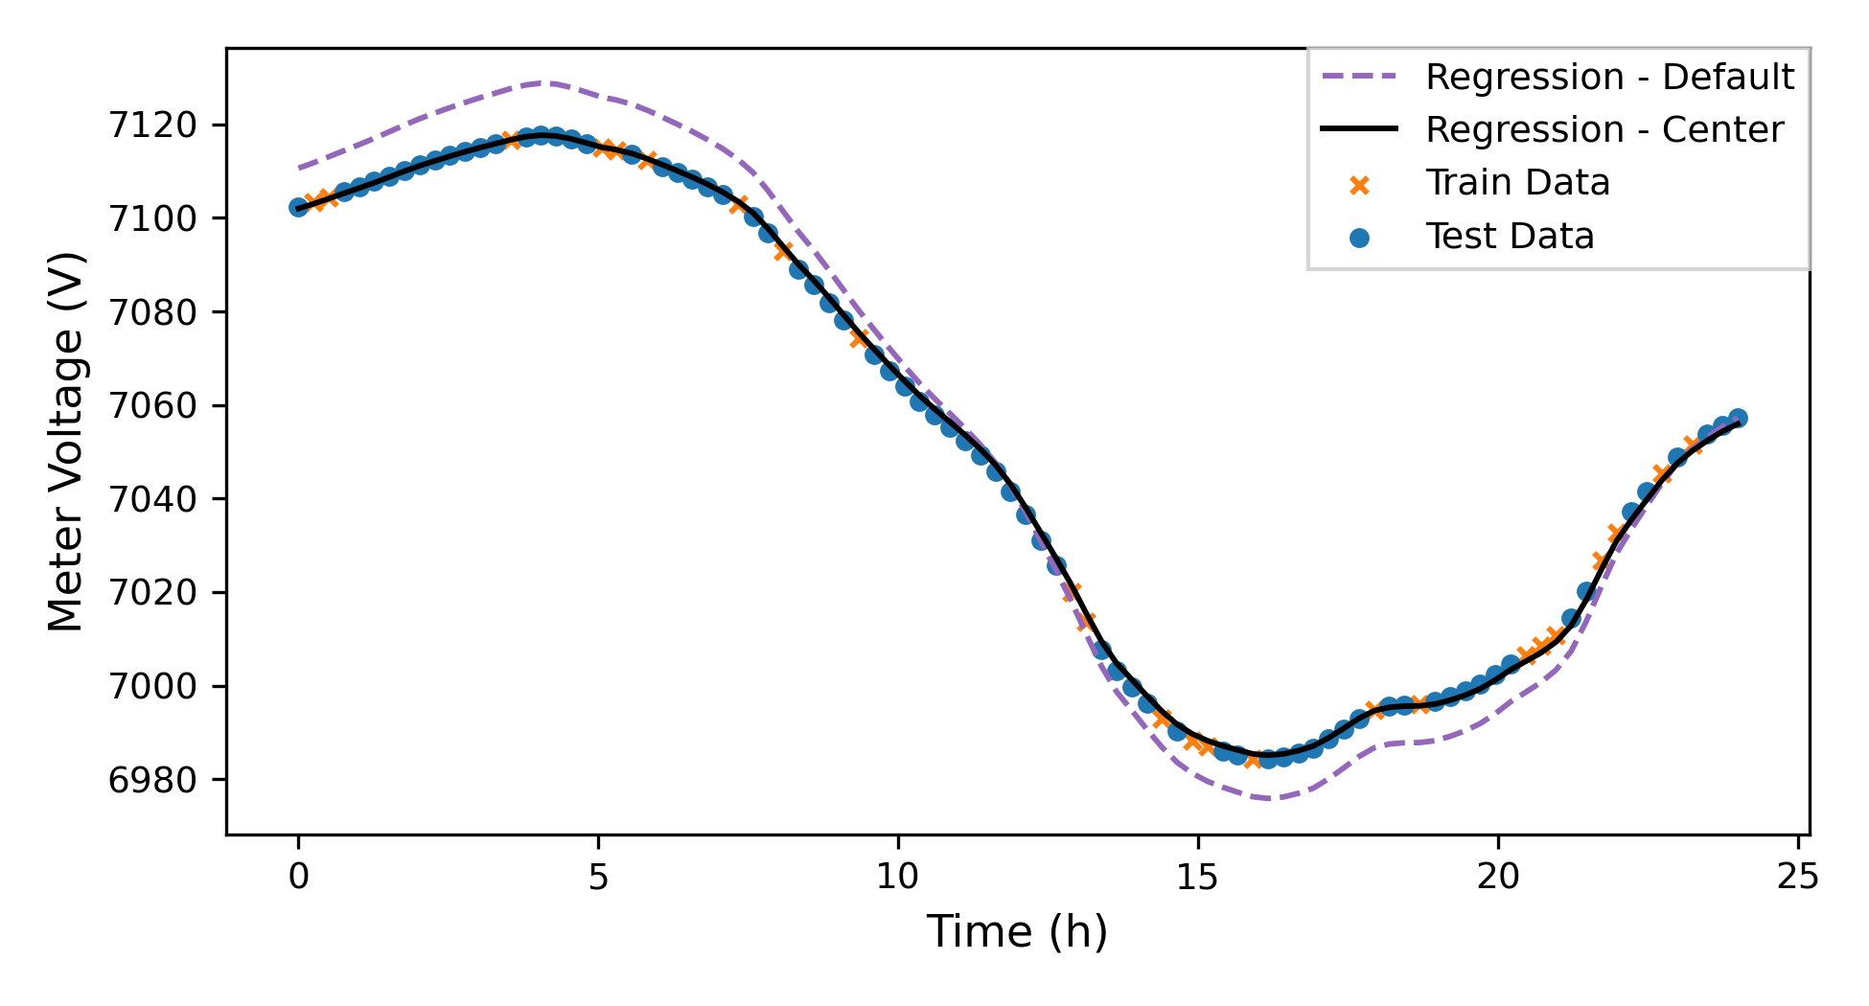
Results – Regression Quality Comparison After 1 Iteration, Realistic PV Penetration (~5%)
Notes:
Next, we consider the accuracy of the regression both with and without preprocessing.
While the CoLA algorithm with preprocessing clearly performs better, the regression quality without preprocessing would likely still be adequate for our proposed use case, as the maximum error in the regression is only around 30 Volts.
However, the combined benefits of the improved convergence behavior and improved regression quality make preprocessing all-but essential, at least for our current data.

Slide 17
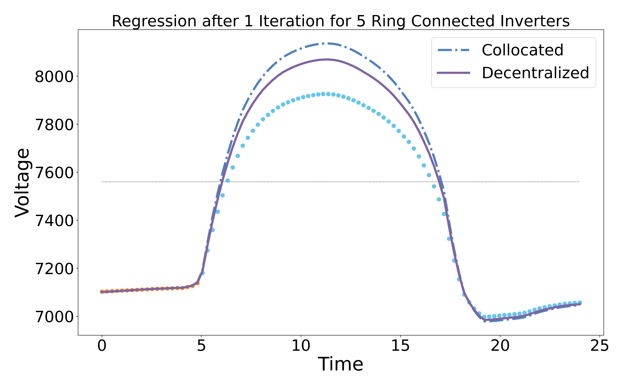
Results – Overvoltage Scenario After 1 Iteration, High PV Penetration (~60%)
Overvoltage
Trained on first 5 hours (healthy grid)
Nominal Voltage
Notes:
One final experiment tested whether our model would be capable of predicting unhealthy grid states, even if trained only while the grid was healthy.
In this case, we compared the CoLA algorithm performed over 16 nodes against a centralized elastic-net regression model, with neither model preprocessing the data.
We found that both models, while trained only between 12:00 AM and 5:00 AM, were able to accurately predict the period during which the upstream meter was overvoltage.
This is a highly promising result for the application space of command verification.
Additionally, the CoLA algorithm slightly outperformed the centralized method in accuracy, despite only running for a single global iteration.

Slide 18
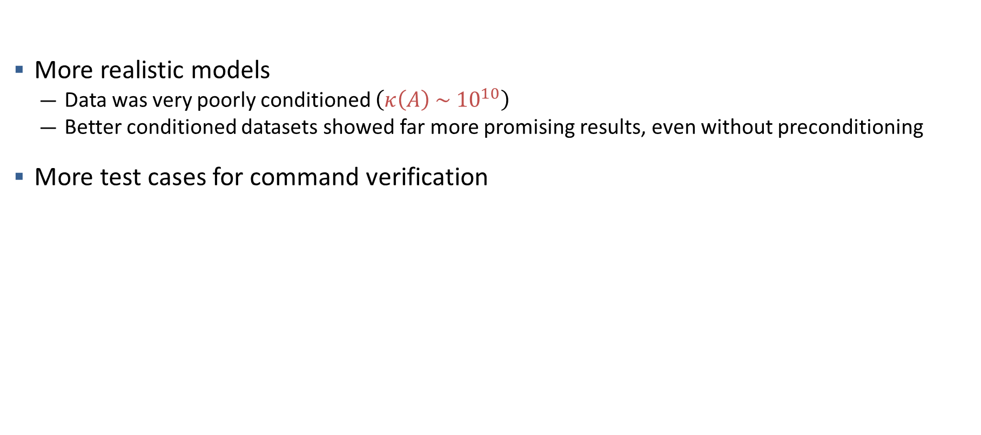
Future Directions
More realistic models
Data was very poorly conditioned $\left(κ\left(A\right) \sim {10}^{10}\right)$
Better conditioned datasets showed far more promising results, even without preconditioning
More test cases for command verification
Notes:
Further experiments on the efficacy of CoLA for decentralized command verification on edge devices will likely require improved grid models which introduce some degree of random noise into the data to improve the overall conditioning of the data matrix.
Additionally, while we tested command verification relating to inverter and meter voltages, there are a wide variety of other potential critical values which should be explored in future research.

Slide 19
Conclusions
CoLA gives useful framework for decentralized learning
Allows for regression without directly sharing private data
Allows for column-partitioned data
Proved potentially effective for the use-case of power grid edge-devices
Notes:
Overall, we found that the CoLA algorithm provides a powerful and general framework for decentralized learning through convex optimization
It does so without requiring the sharing of the local, column-partitioned data; a feature not found in many other decentralized algorithms
This is only made possible through the use of an auxiliary vector which approximates the necessary global vector $Ax$
Ultimately, CoLA proved to be a promising algorithm for edge-device computing.
However, there are several key improvements, including greater resiliency measures and a clear, local stopping criteria, which will be necessary before CoLA will be viable for use in this application space.

Slide 20
Questions?

Slide 21
This work is supported by the U.S. Department of Energy’s Office of Energy Efficiency and Renewable Energy (EERE) under Solar Energy Technologies Office (SETO) Agreement Number 34229.
Disclaimer
This document was prepared as an account of work sponsored by an agency of the United States government. Neither the United States government nor Lawrence Livermore National Security, LLC, nor any of their employees makes any warranty, expressed or implied, or assumes any legal liability or responsibility for the accuracy, completeness, or usefulness of any information, apparatus, product, or process disclosed, or represents that its use would not infringe privately owned rights. Reference herein to any specific commercial product, process, or service by trade name, trademark, manufacturer, or otherwise does not necessarily constitute or imply its endorsement, recommendation, or favoring by the United States government or Lawrence Livermore National Security, LLC. The views and opinions of authors expressed herein do not necessarily state or reflect those of the United States government or Lawrence Livermore National Security, LLC, and shall not be used for advertising or product endorsement purposes.

